Slide 1

MICROSOFT ENGAGE 2022 FINAL PROJECT Newflicks ~ Shivani Gupta MCA – NIT RAIPUR

Slide 2


Algorithms Recommendation Engine

Slide 3



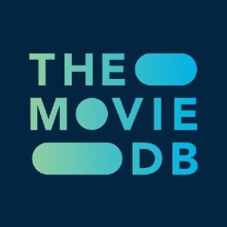
TECH STACK
Next.js is an open-source web development framework built on top of Node.js enabling React based web applications functionalities such as server-side rendering and generating static websites.
Vercel is a platform for frontend frameworks and static sites, built to integrate with your headless content, commerce, or database.
Firebase is a platform developed by Google for creating web and mobile applications. It is used to provide authentication and database.
The API service is for those of you interested in using movie, TV show or actor images & data in application.

Slide 4

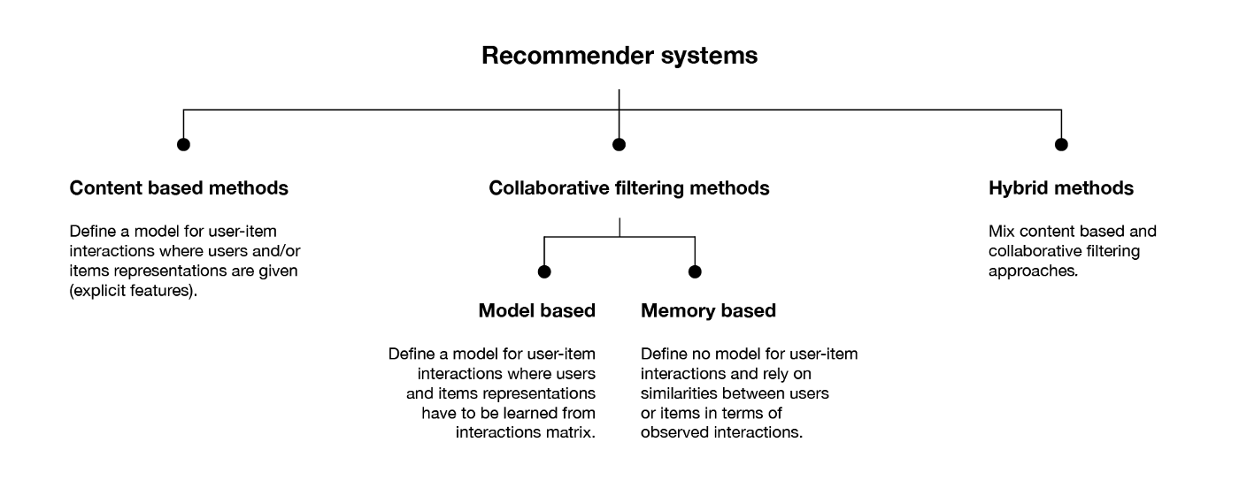

Slide 5
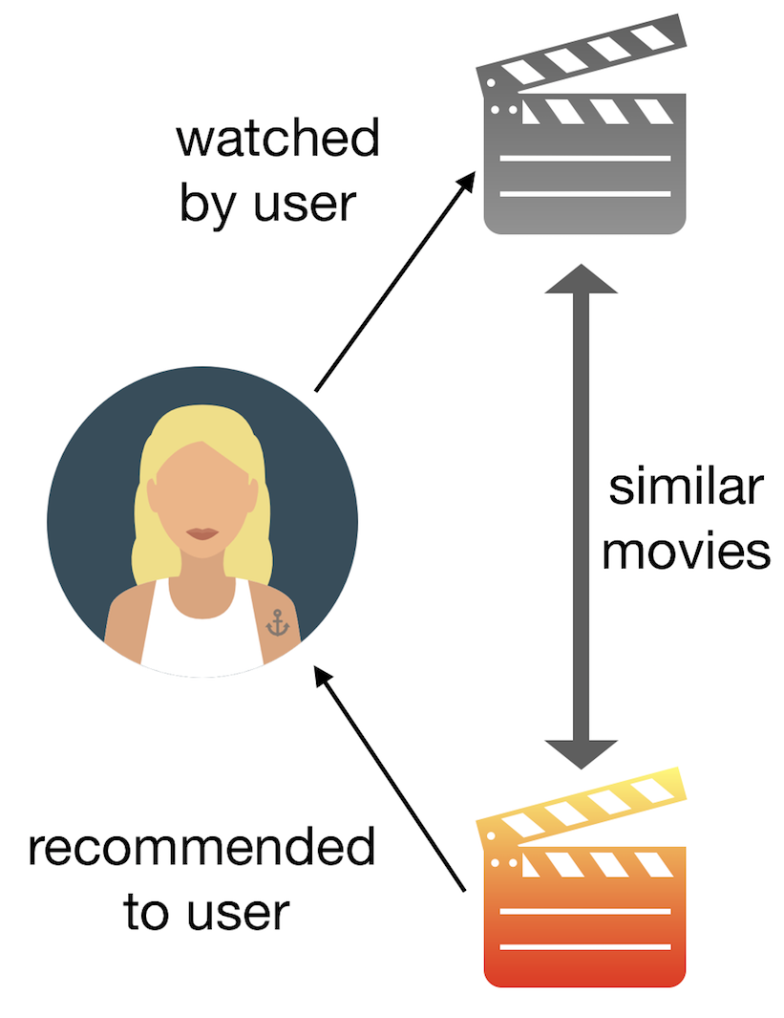
METHODS USED FOR FILTERING DATA
KNN algorithm: For filtering data by calculating Euclidian distance to get the nearest matches.
Content based filtering.
Filtering based on user watched history.
Recommendation based on movies added in watch list.

Slide 6
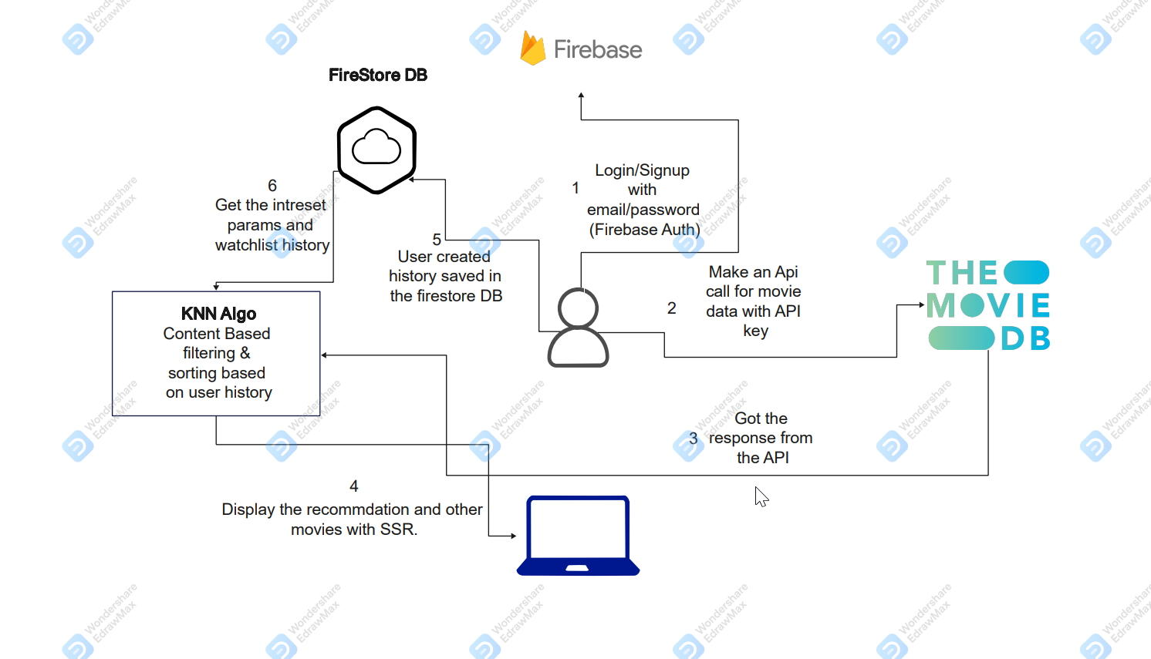
ARCHITECTURE DESIGN

Slide 7

PROJECT
Screenshots
on
Laptop

Slide 8
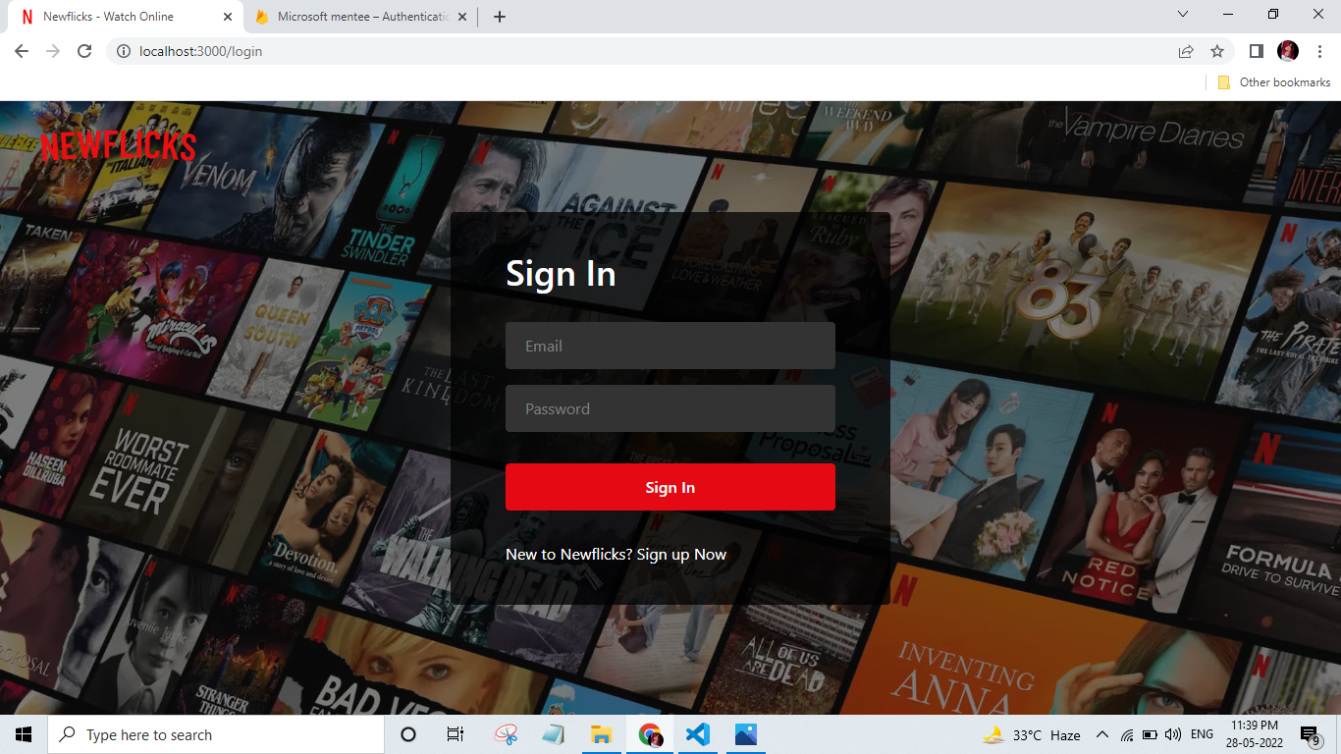

Slide 9
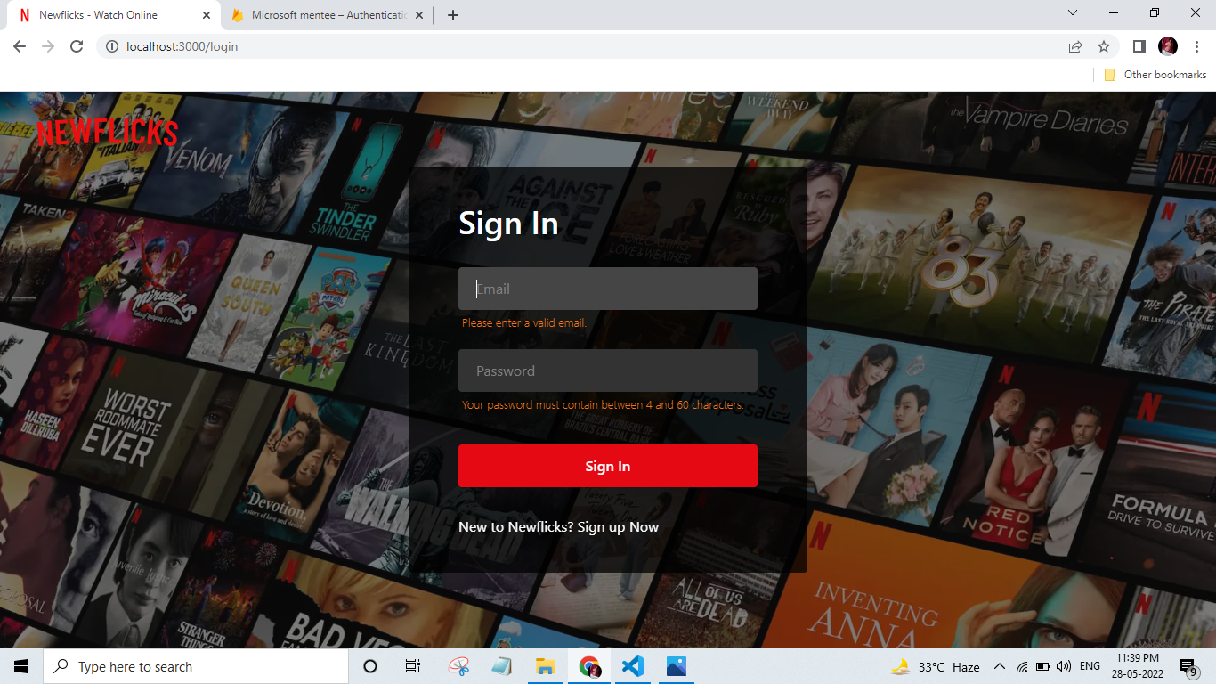

Slide 10
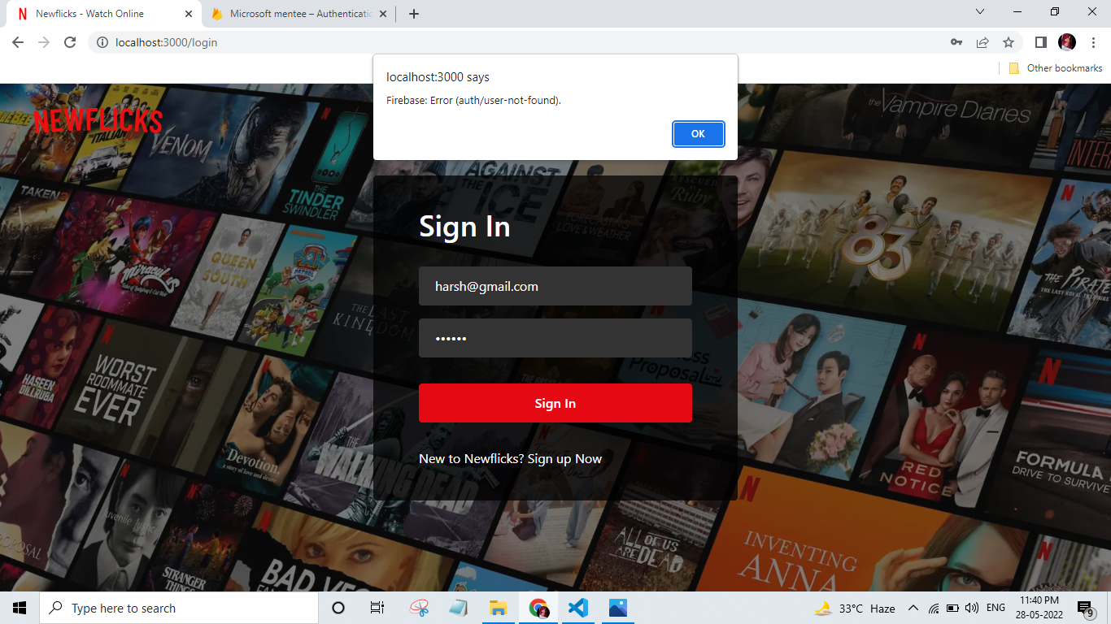

Slide 11
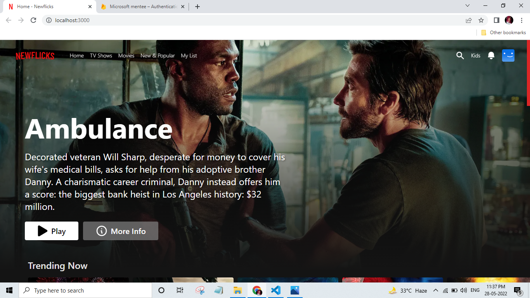

Slide 12
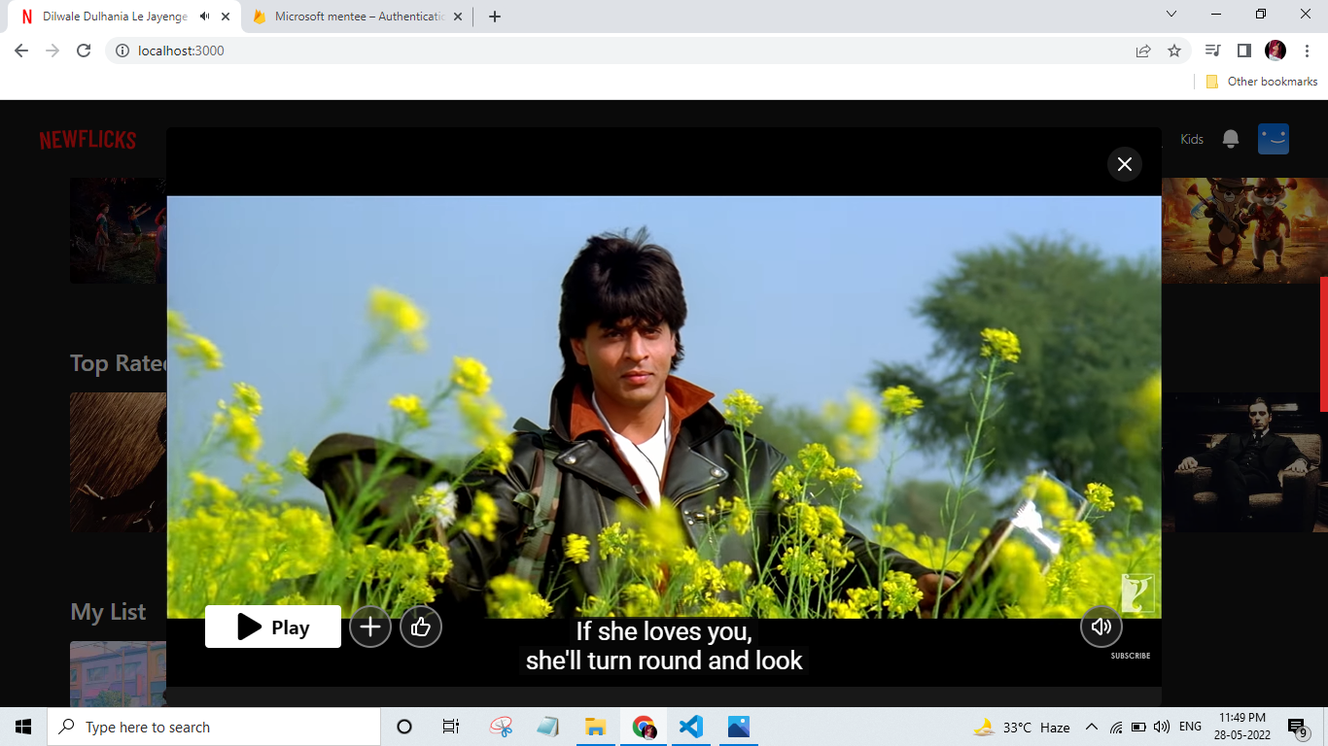

Slide 13
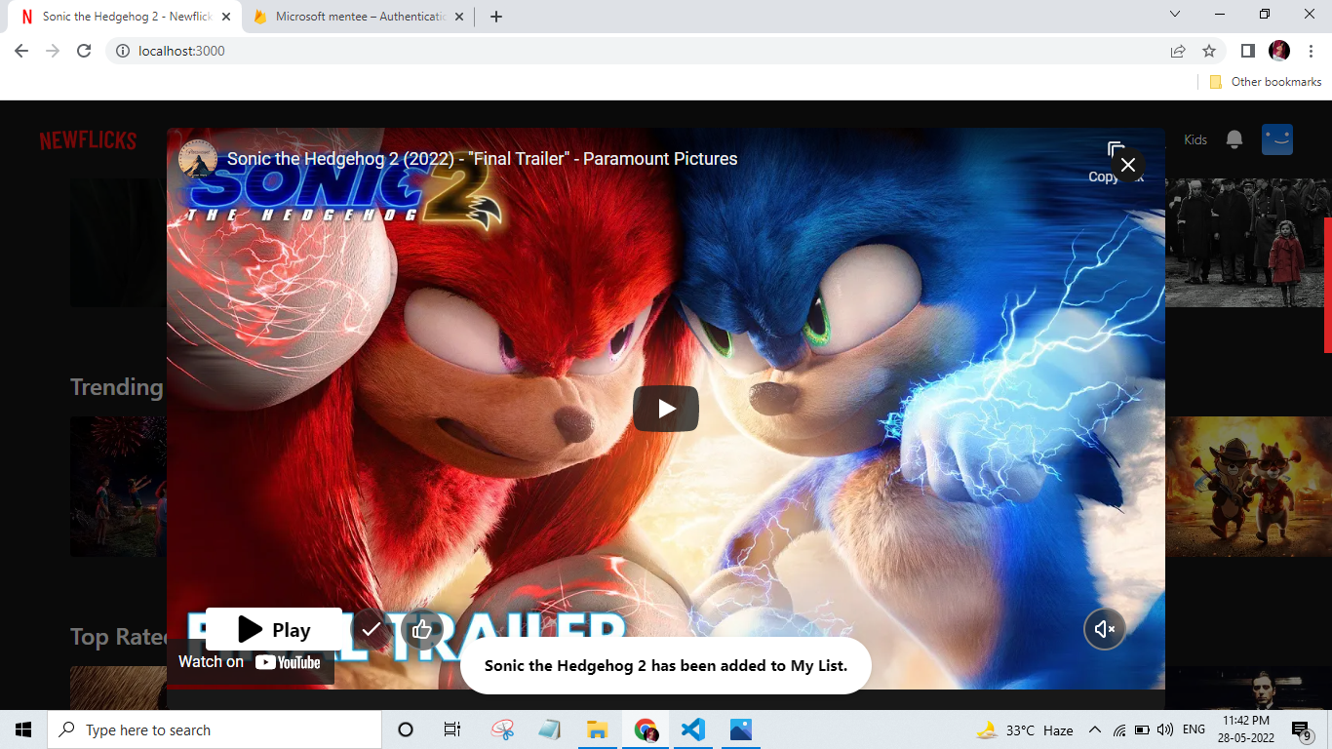

Slide 14
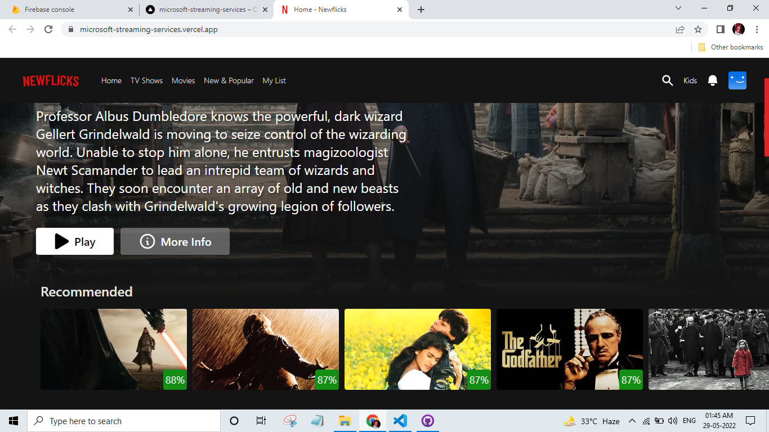

Slide 15
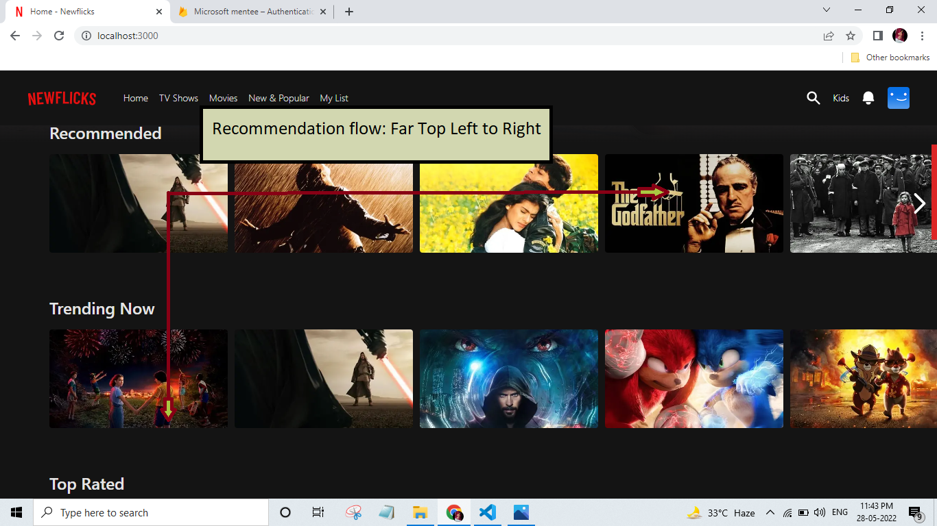

Slide 16
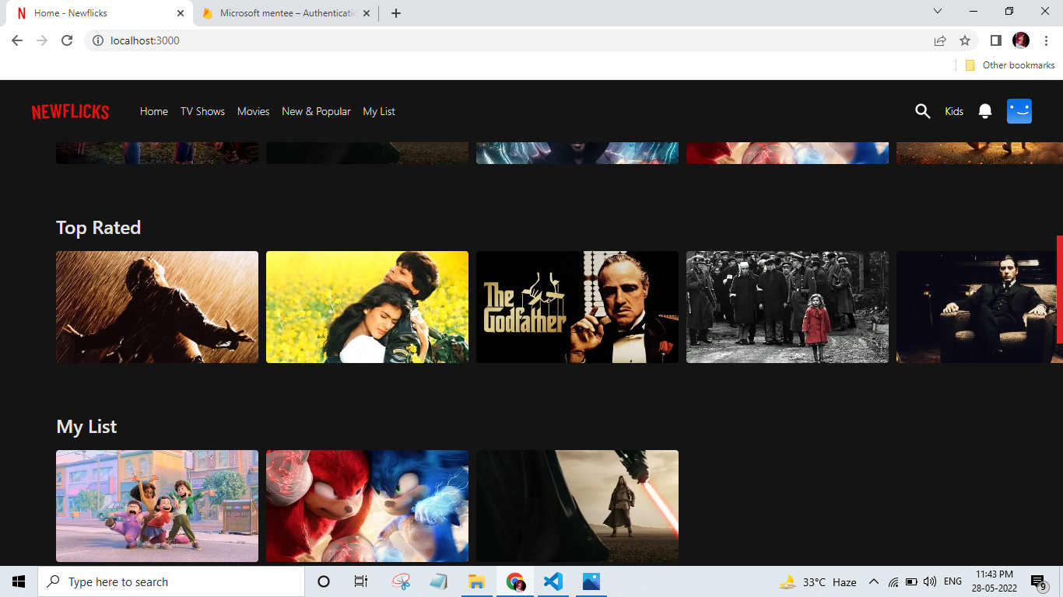

Slide 17
Screenshots on Phone

Slide 18
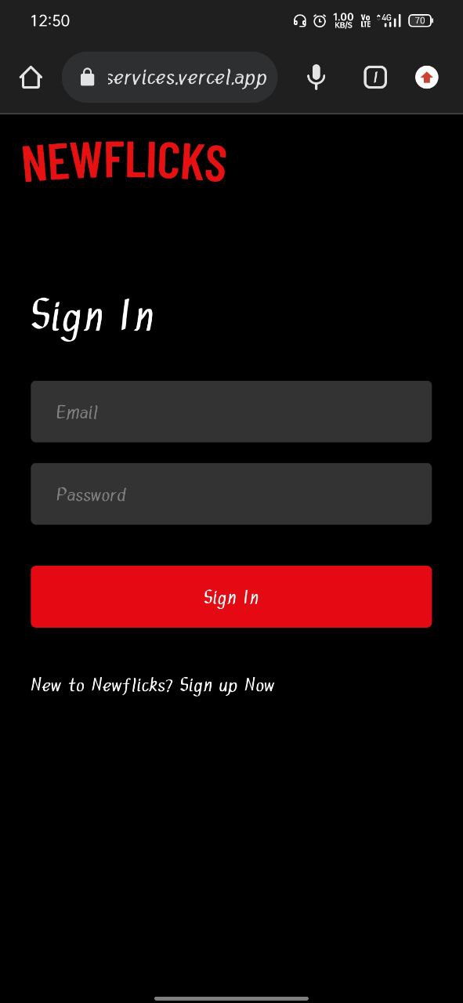
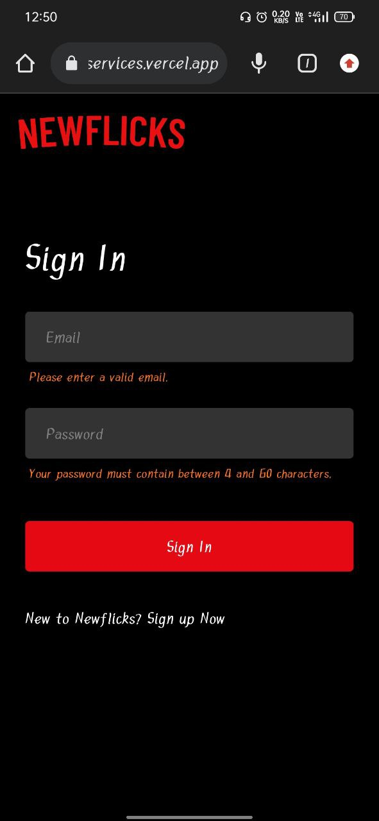
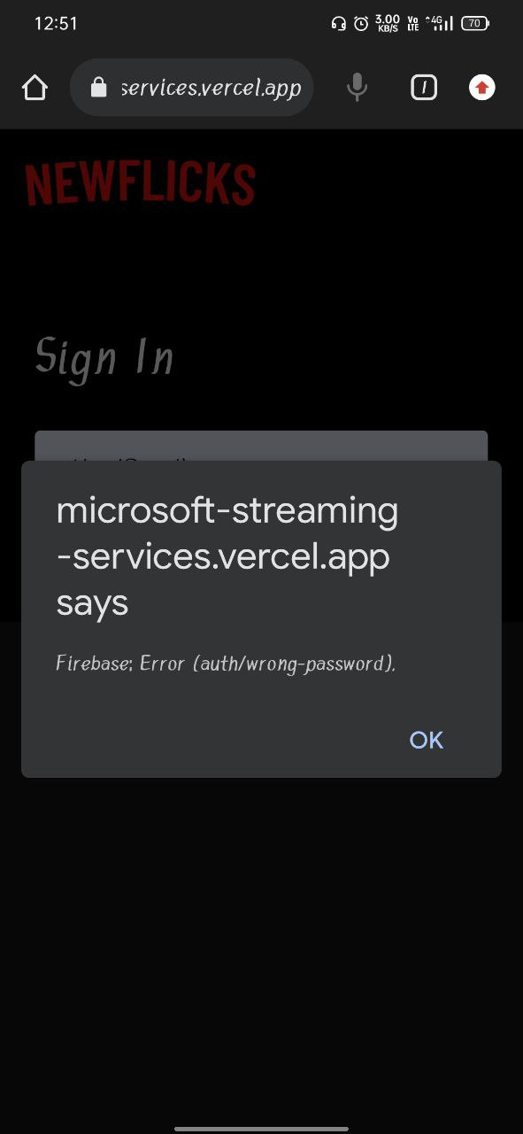

Slide 19
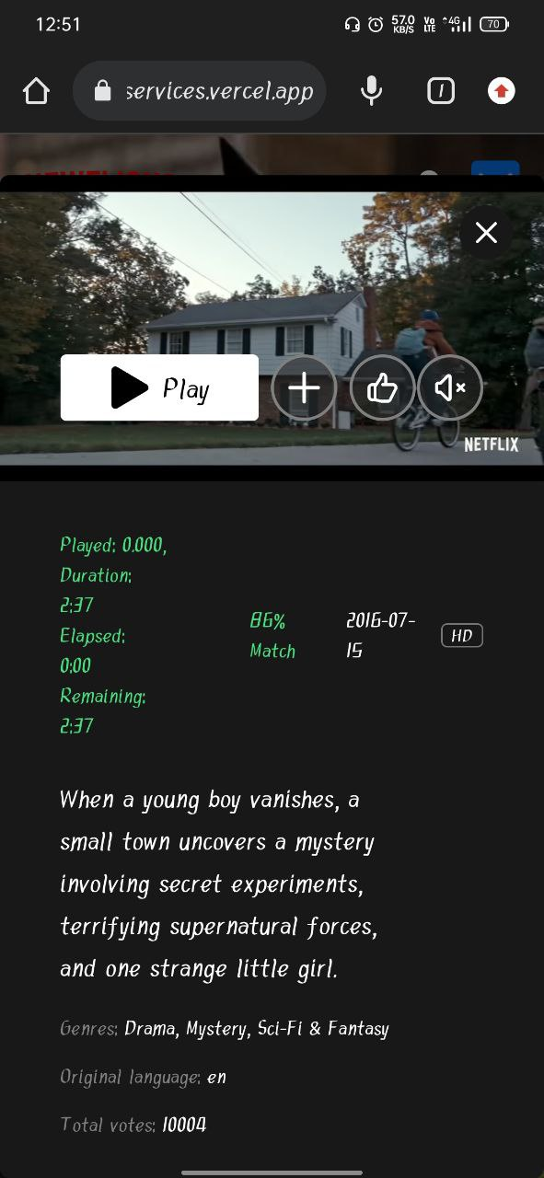
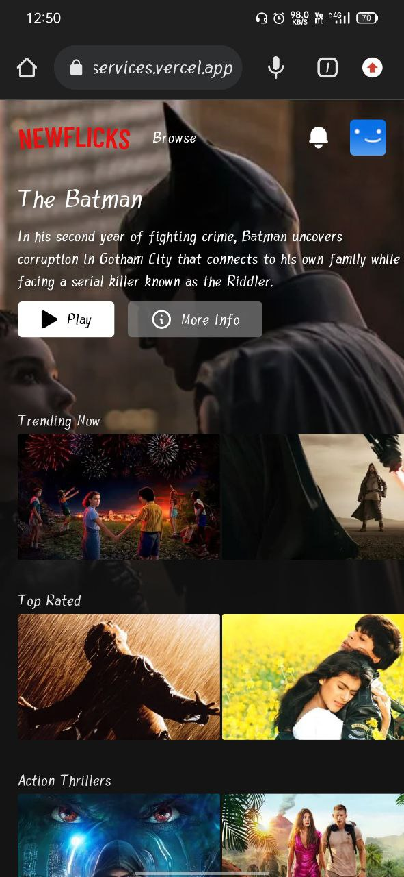
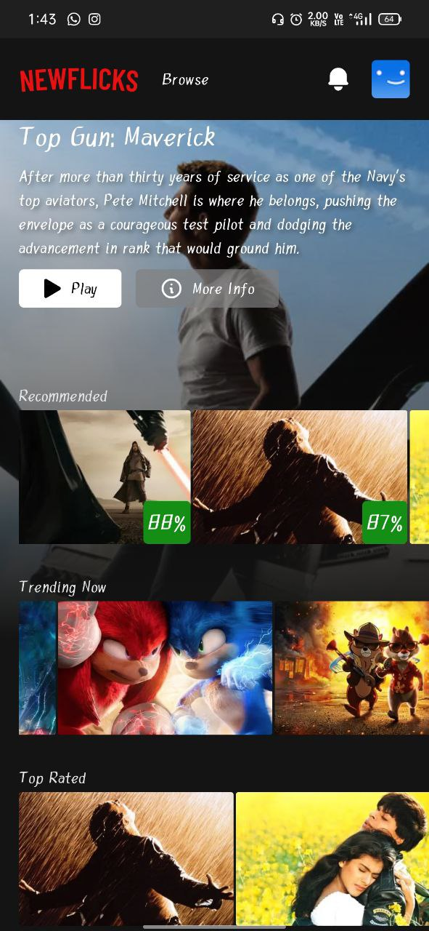

Slide 20
Tech Stack

Slide 21
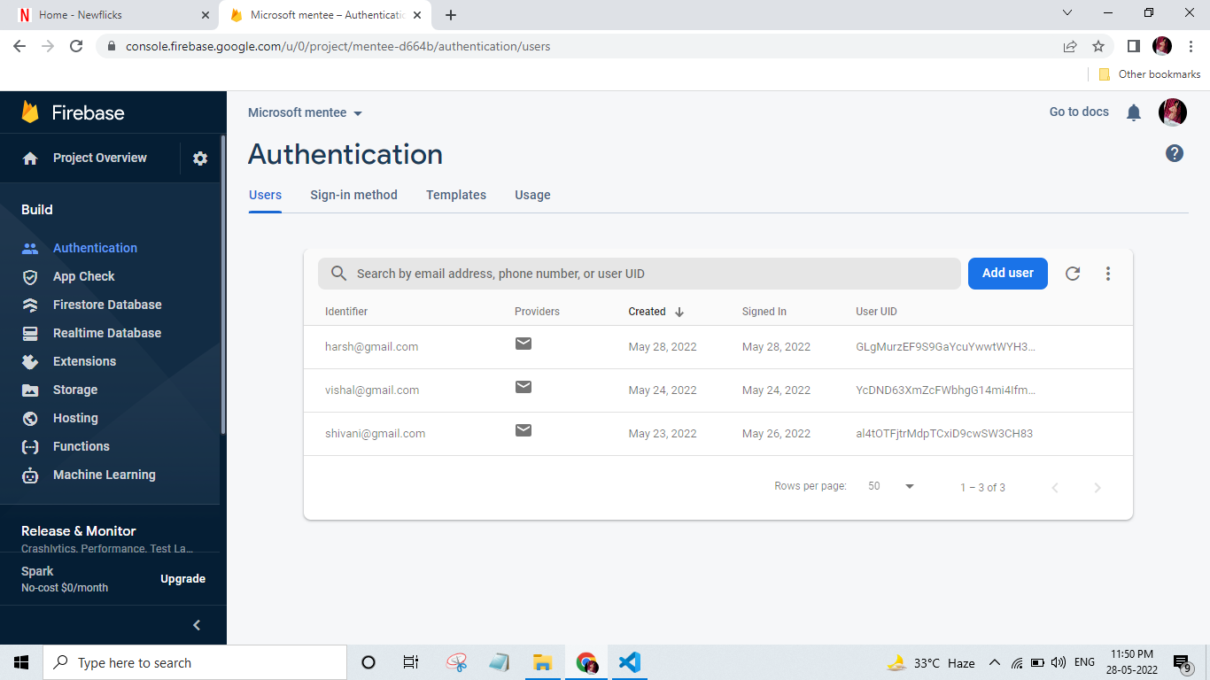

Slide 22
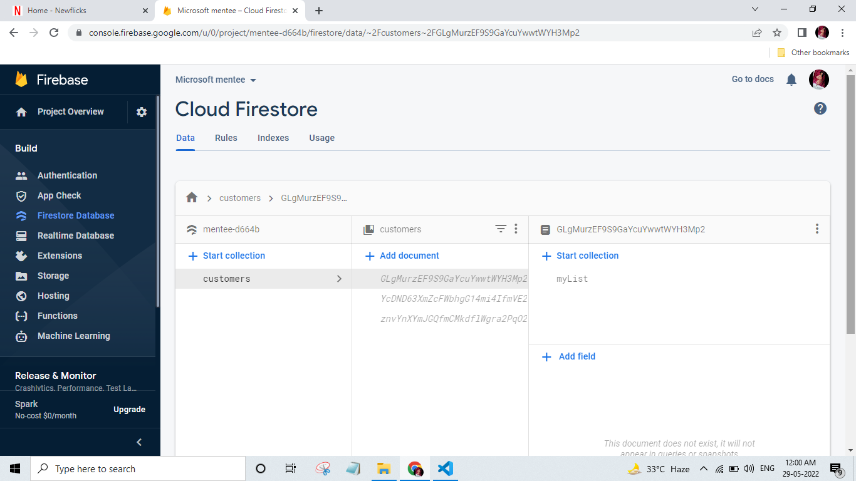

Slide 23
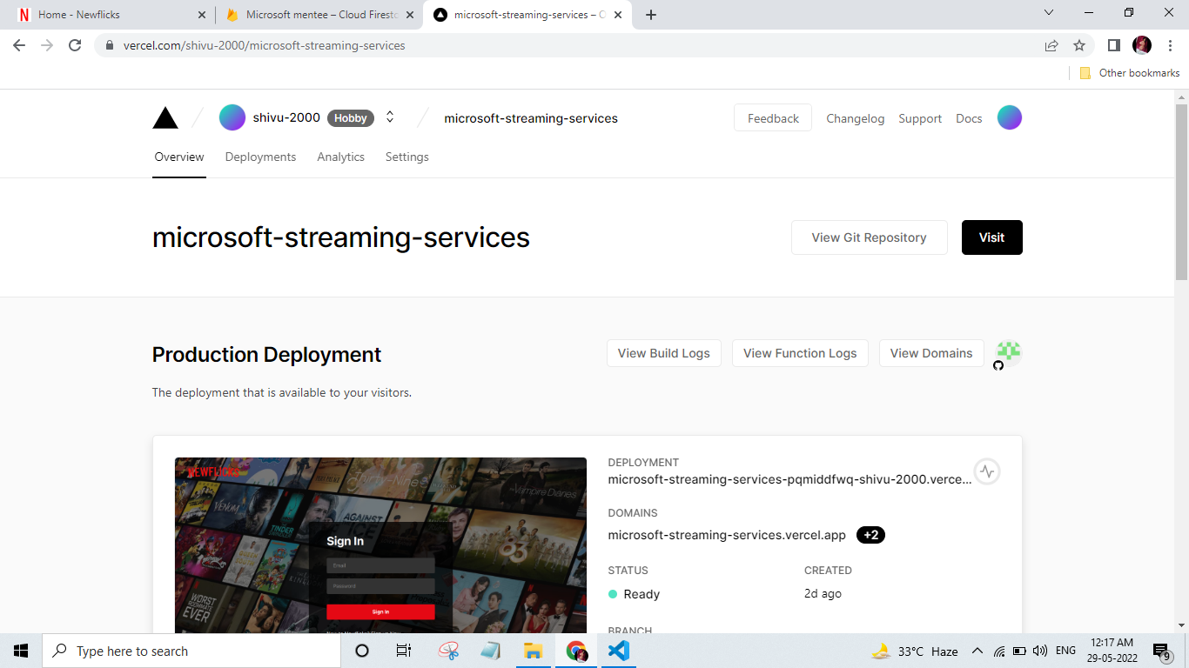

Slide 24

FUTURE SCOPE
Better recommendation system using collaborative and hybrid trained model by using ML.
Locality based recommendation system.
Better code coverage to ensure & maintain the code quality.
Add support for scalability.

Slide 25
THANK YOU!

